Slide 1




Slide 2

http://snip.bt.com/listen listen@bt.com Text '81192' starting your message p2psn

Slide 3
The Peer to Peer Support Network provides informal Mental Health Support across the whole of BT
http://snip.bt.com/listen listen@bt.com Text '81192' starting your message p2psn

Slide 4
http://snip.bt.com/listen listen@bt.com Text '81192' starting your message p2psn

Slide 5

Details at http://snip.bt.com/listen
http://snip.bt.com/listen listen@bt.com Text '81192' starting your message p2psn

Slide 6
http://snip.bt.com/listen listen@bt.com Text '81192' starting your message p2psn

Slide 7
To become a volunteer…
http://snip.bt.com/listen following the link to
What can I do to help others ?
http://snip.bt.com/listen listen@bt.com Text '81192' starting your message p2psn

Slide 8
http://snip.bt.com/listen listen@bt.com Text '81192' starting your message p2psn

Slide 9
To find a listening ear… http://snip.bt.com/listen following the link to
Search for Volunteers
http://snip.bt.com/listen listen@bt.com Text '81192' starting your message p2psn

Slide 10
http://snip.bt.com/listen listen@bt.com Text '81192' starting your message p2psn

Slide 11
To find resources to help you
http://snip.bt.com/listen following the link to
What can I do to help myself ?
http://snip.bt.com/listen listen@bt.com Text '81192' starting your message p2psn

Slide 12
http://snip.bt.com/listen listen@bt.com Text '81192' starting your message p2psn

Slide 13
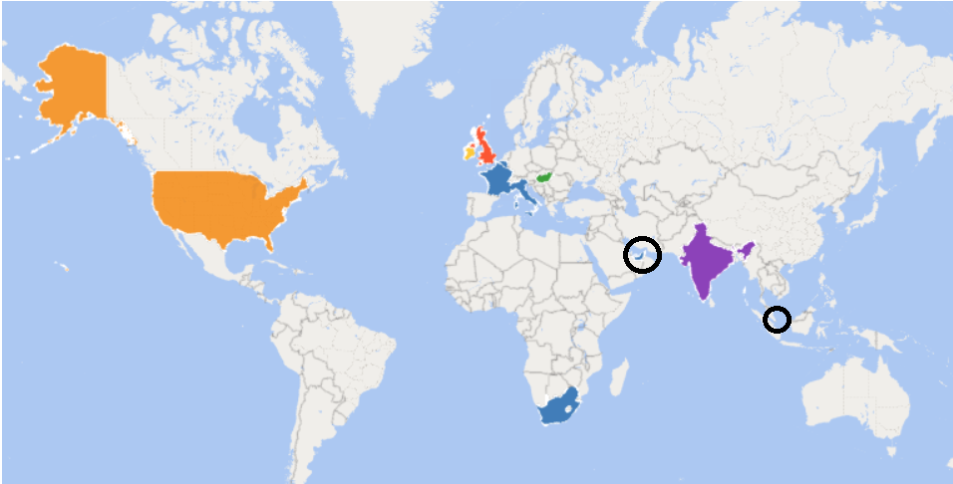
United Kingdom | 575
Hungary | 17
Ireland | 13
India | 5
United States | 2
France | 1
UAE | 1
Italy | 1
Belgium | 1
Singapore | 1
South Africa | 1
We have members across the World

Slide 14
http://snip.bt.com/listen listen@bt.com Text '81192' starting your message p2psn

Slide 15
We have the support of:
BTs Chief Medical Officer: Dr Richard Caddis
Head of BT Welfare: Bruce Greenhalgh
BT Volunteering team
Prospect and CWU
http://snip.bt.com/listen listen@bt.com Text '81192' starting your message p2psn

Slide 16
http://snip.bt.com/listen listen@bt.com Text '81192' starting your message p2psn

Slide 17
Today
We have 618 members
Many trained in Mental Health Support &
able and available to be a ‘listening ear’ to anybody in BT
http://snip.bt.com/listen listen@bt.com Text '81192' starting your message p2psn

Slide 18
http://snip.bt.com/listen listen@bt.com Text '81192' starting your message p2psn

Slide 19
The volunteers have experience of:
abuse - armed forces - autism spectrum conditions - anxiety - bereavement - bi-polar disorder - cancer support - chronic pain management - dementia - depression - divorce - drugs and alcohol issues - eating disorders - epilepsy - gambling addiction - migraines -
obsessive compulsive disorders (OCD) - post-natal depression -
post-traumatic stress disorder - psychosis conditions - stress & burnout
http://snip.bt.com/listen listen@bt.com Text '81192' starting your message p2psn

