Slide 1
Notes:
IOSH Webinar New legislation on EMF 30 Nov 2016

Slide 16
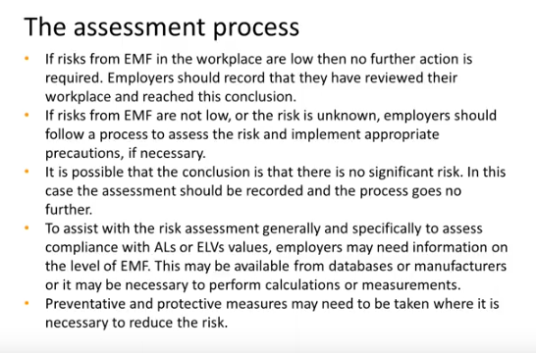

Slide 23
ALL INFORMATION OWNED BY JULIA CLARK

