Slide 4
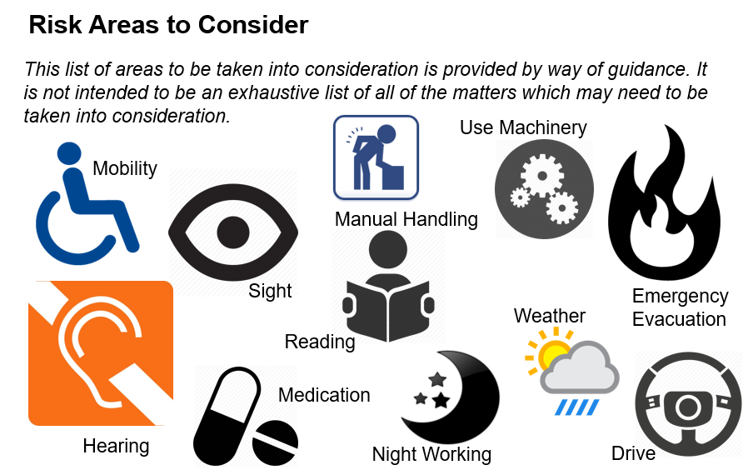
Each case is different …. But similarities do often exist…….

Slide 5
So what can be done to support? Can adjustments be made?

Slide 6
Lets share 3 examples of simple ‘Reasonable’ adjustments….

Slide 7
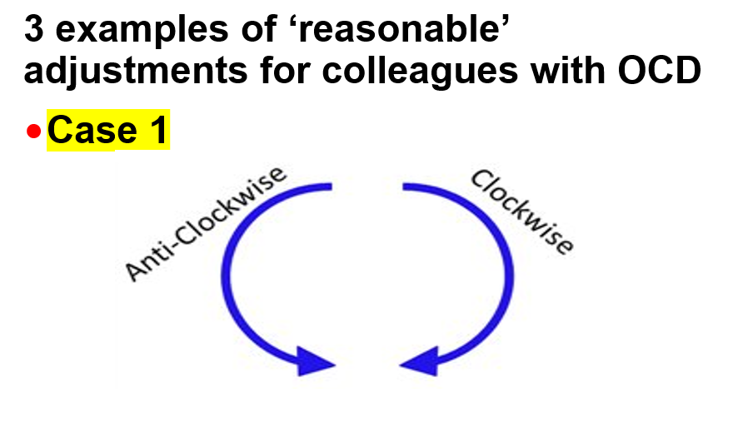

Slide 8
CASE 1 –COMPULSION/ OBCESSION WITH ‘THE ANTI- CLOCKWISE THEORY’
The Superior vena-cava collects de-oxygenated blood to the heart aided by heart suction. This vein carries blood from left to right. Centrifugal force due to anticlockwise walking/running helps this suction. If we run clockwise, the centrifugal force impedes suction. That is why, in olden days, health officers ensured that all carnival merry-go-rounds were run only in the anti-clockwise direction.

Slide 9
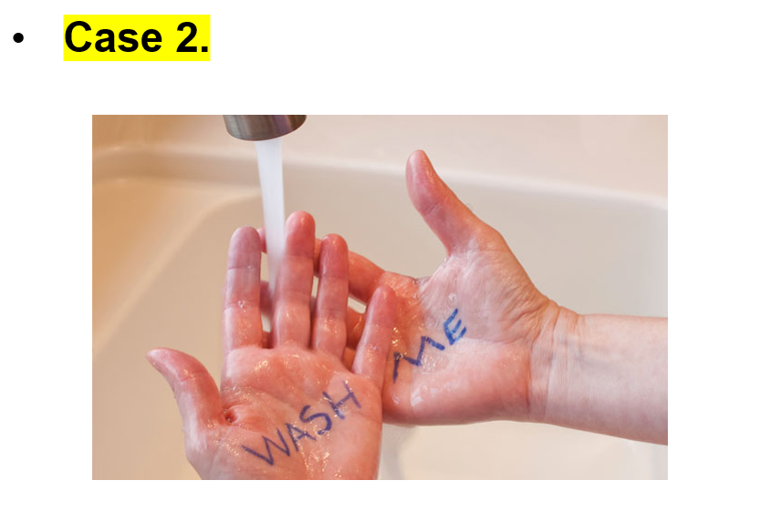

Slide 10
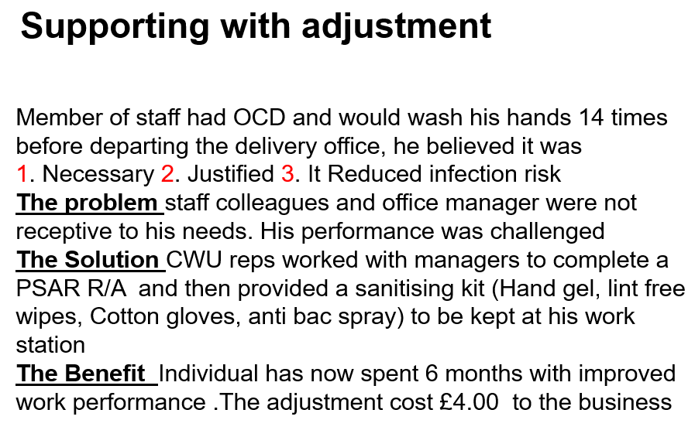
CASE 2 – GERMOPHOBIA Excessive washing is a sign of OCD. Germaphobia often leads to excessive hand washing. ... Obsessive fear of germs or dirt and the compulsion to wash the hands over and over is one of the most common manifestations of obsessive-compulsive disorder (OCD).

Slide 12
CASE 3- RITUALISTIC EATING
Eating rituals refer to any compulsory behaviors around food, the preparation of food, the consumption of food, or any situation involving food or eating Many sufferers of obsessive compulsive disorder (OCD) have extreme rituals around food and eating

Slide 13
Thinking about supporting with a reasonable adjustment…………..
It is important that individuals are fully involved, so they can influence decisions about what would be effective for them.
Try and establish what adjustments are needed and review and monitor once implemented so that any reasonable adjustment can change as a persons condition can change.
Think about how a colleagues Mental health condition and medication may impacts on their ability to carry out their job.
The Reasonable adjustment agreements should be detailed in a person specific risk assessment.
5. Retain privacy and confidentiality agreements throughout

Slide 14
Rethink Mental Illness have identified the importance of workspace ‘Quiet areas’ or Quiet Rooms’ or dedicated ‘Quiet Spaces’ Q- Why???
A- The level of activity and noise in the workplace can have a serious effect on how people are able to work.
A noisy, busy workplace can be difficult to cope with, So changing the workspace physically could help.

Slide 16
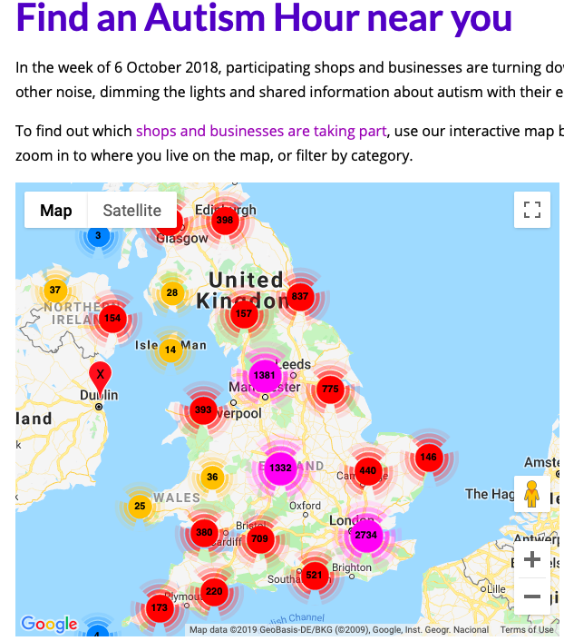

Slide 17
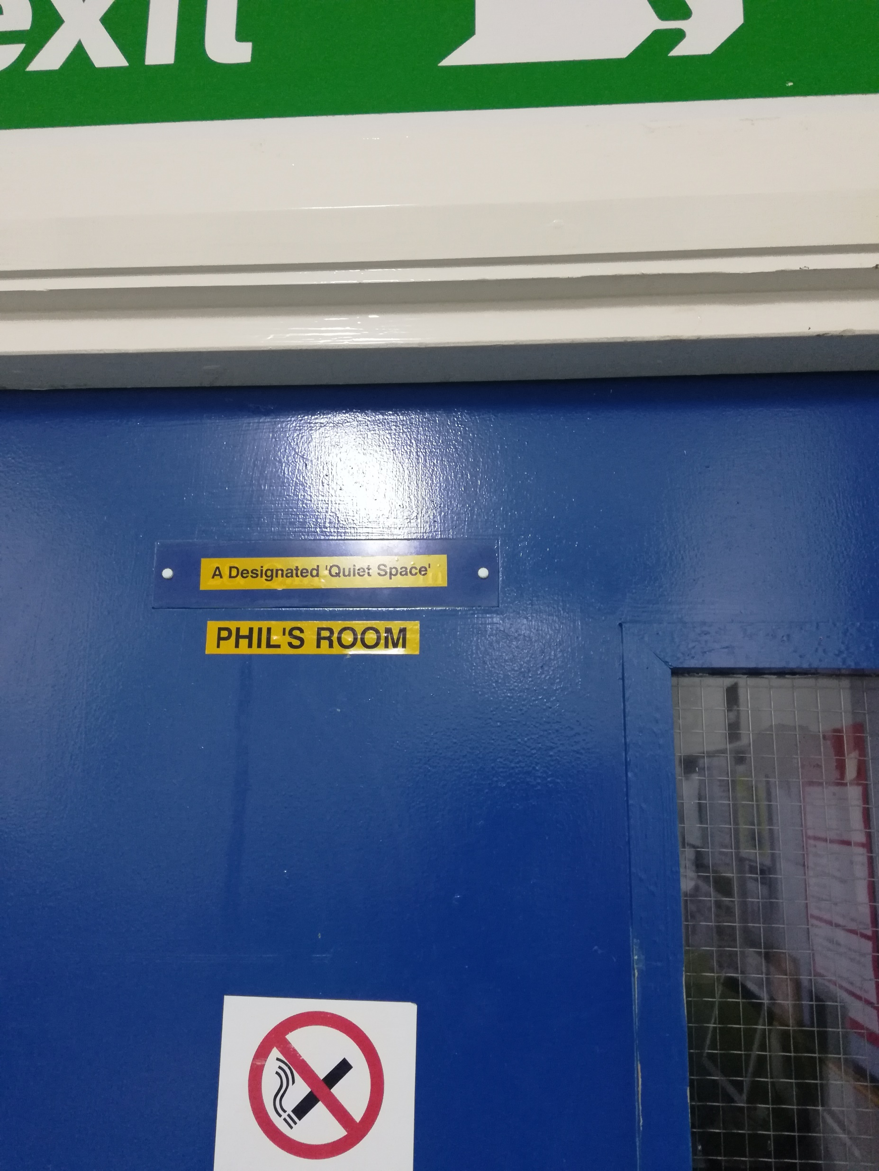
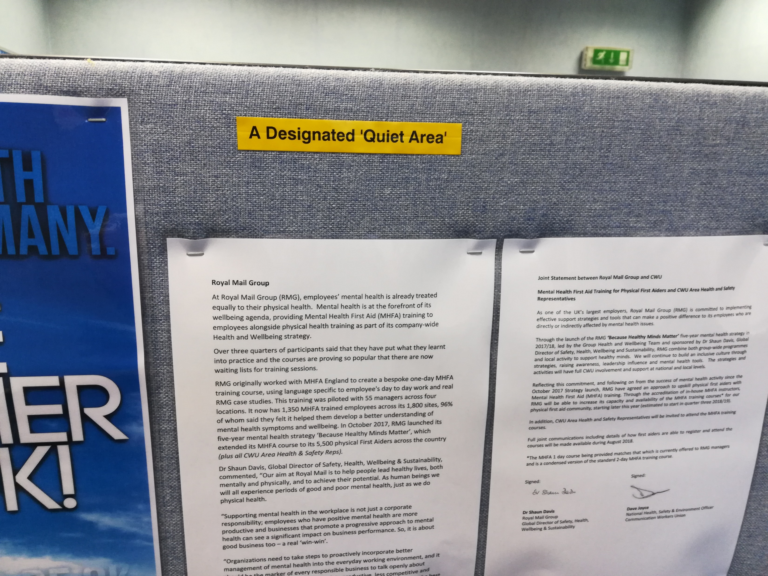
WALLASEY D.O.. We now have a dedicated ’Quiet room’ where staff can go if they feel they need a break in a quiet area away from the canteen or their workstation and this area has been filled with supporting Mental Health information

Slide 18
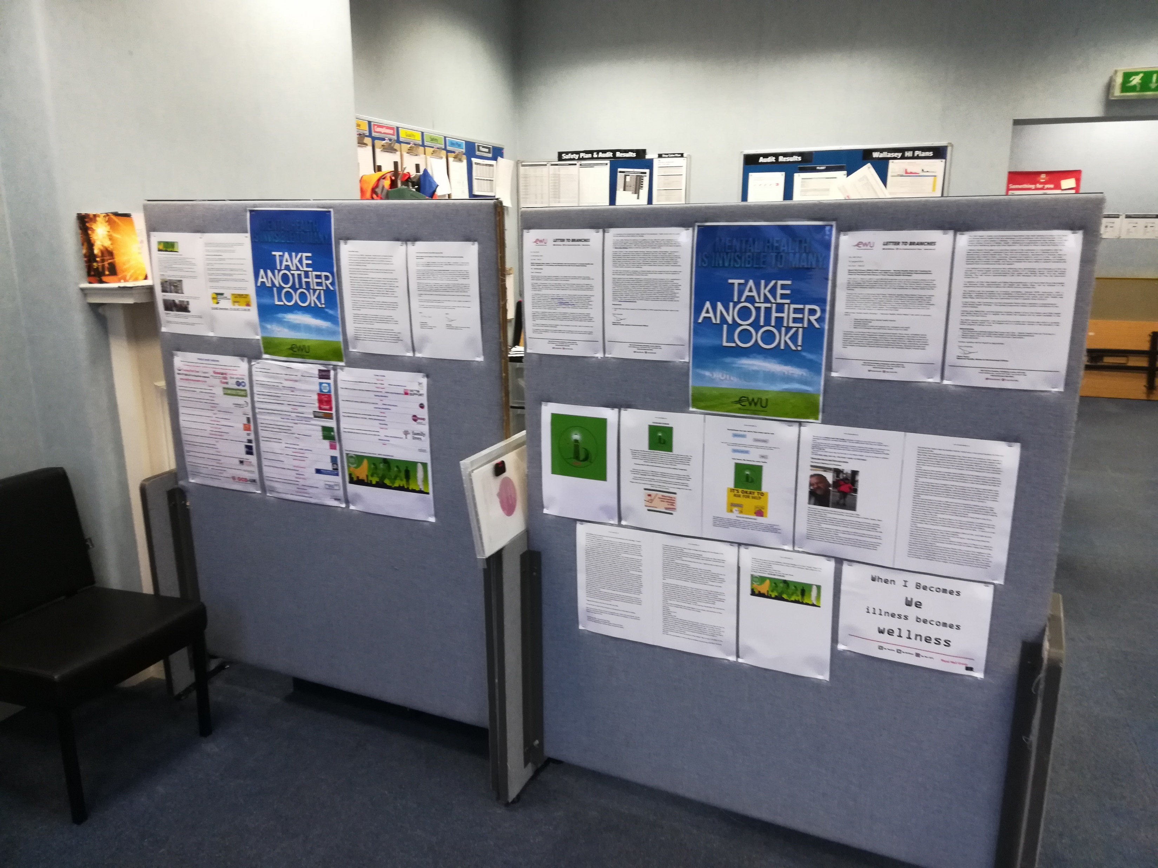
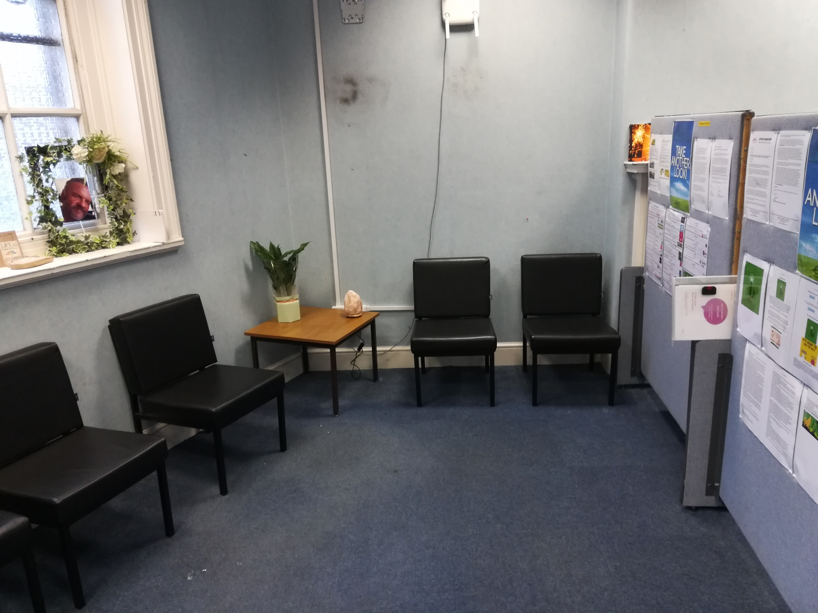

Slide 19
Quiet rooms can be a key area for displaying supporting information………

Slide 20
‘Recharge rooms’ are now very popular in America……
'Recharge Rooms' Are the Next Trend Your Employees Need in the Office!!
Introducing...Recharge Rooms-
These are more than a simple café or chair grouping in a convenient place for conversation between colleagues or that morning java that gets the juices flowing. They're rooms where employees can take a few minutes of downtime to zone out, relax, stretch, nap, or even meditate.
The idea is to unwind, get away from the stresses of the job long enough that the brain resets, and when the batteries are fully recharged, the employee emerges ready to tackle even the toughest projects with renewed energy.

Slide 21
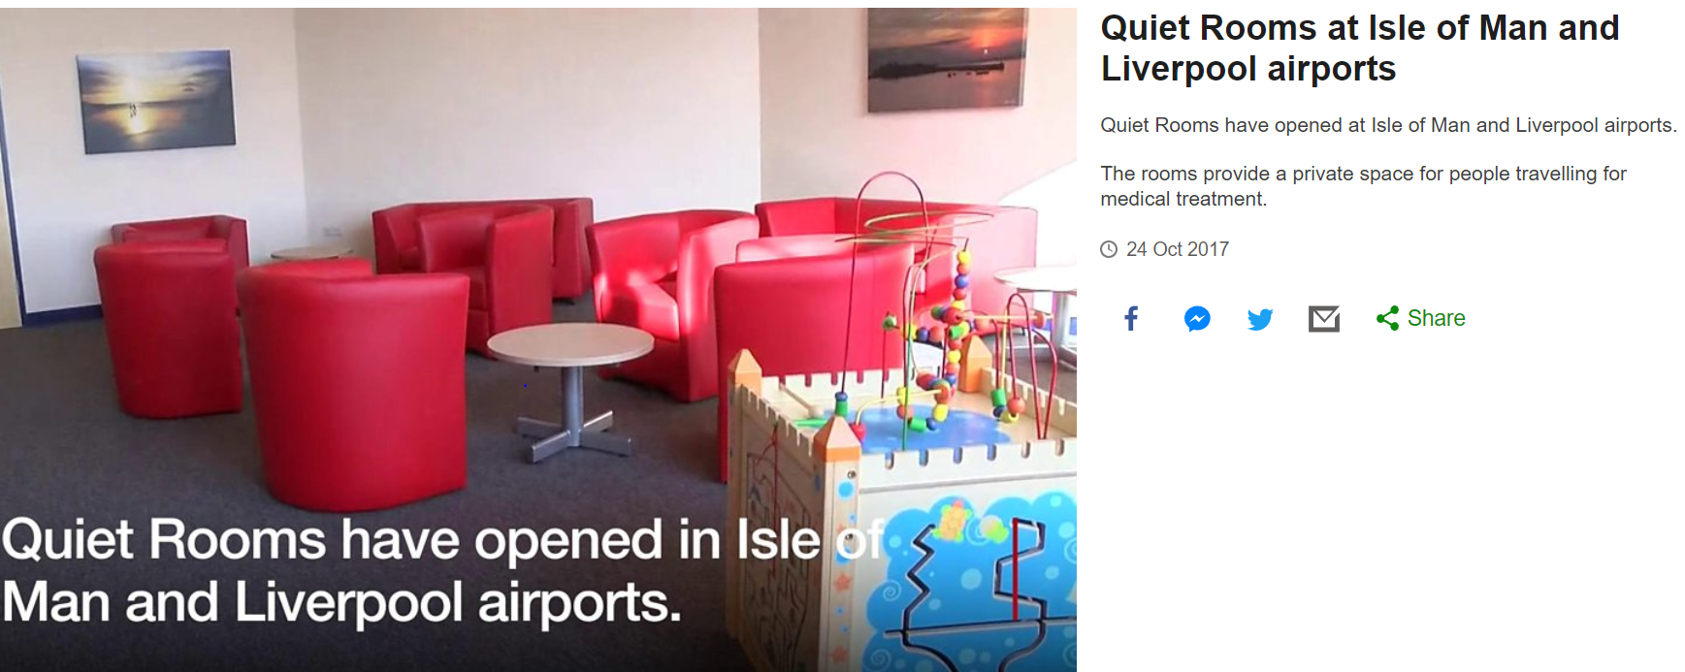
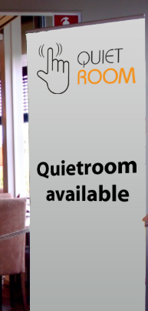
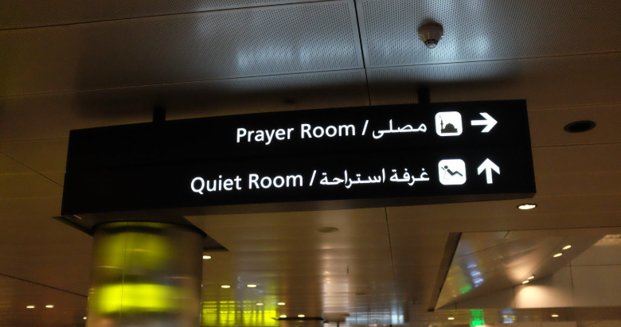
Many Airports now have Quiet rooms……. So why not adopt this idea in the workplace ???

Slide 22
Quiet Room suggestions for the workplace ……..
When it comes to rules, less is more. There shouldn’t be any formal rules needed for using a quiet room, however the employees who use Quiet Rooms should understand the need to respect the reason why its there
2. Avoid allowing the room be used for other purposes. Resist the temptation to use the room as a break room, meeting room, a place to make phone calls or access the Internet etc.
3. Involve staff in the creation of the room. When furnishing the room focus on comfort with standard furnishings include: comfortable chairs, a small table (employees often bring in books to share).
4. Not all employees will use the room regularly, but those who do may consider it vitally important. Those using a quiet room/area will often find that taking time out to sit and “do nothing” for as little as 10 minutes during the work day can make the difference between a good day and bad one.
5. Include an information notice board.
Anyone seeking information or supporting information from organisations or telephone numbers should be able to readily have access to this information.

Slide 23
A final thought on why workplace support is so important…………..

